Slide 1
UAV Ground Detection
Distinguish Tree Species
Christian Ekeigwe, Daehyeon Jeong, Jaeyeong Shim, Jeonghwan Kang, Seoungheong Jeong
Project 17

Slide 2
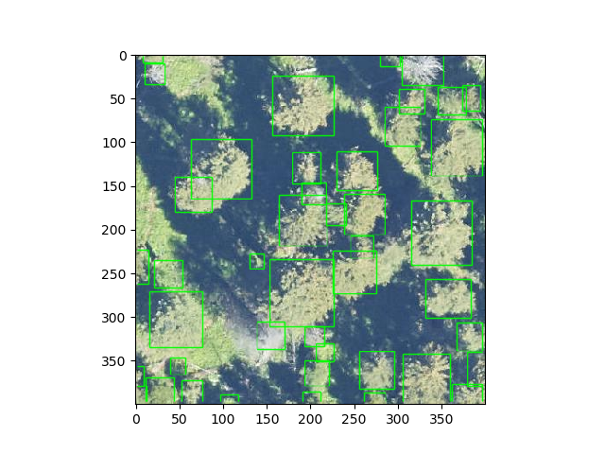
Detecting Tree model
Deep Forest
Training and predicting individual tree airborne RGB image
https://deepforest.readthedocs.io/en/latest/landing.html

Slide 3
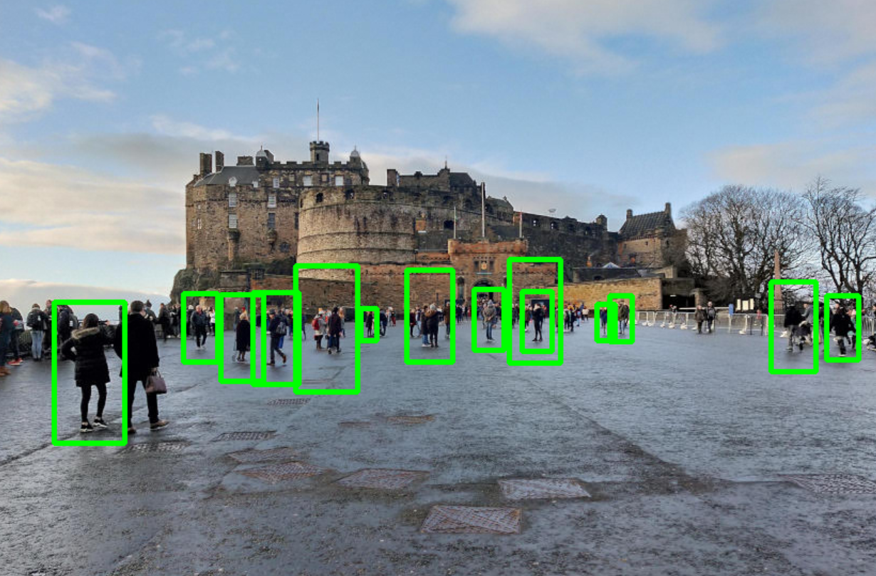
Detect Objects in Real Time
Using OpenCV and Python
When using UAV ground detecting we need to use real time object detection
OpenCV?
library of programming functions mainly aimed at real-time computer vision.

Slide 4
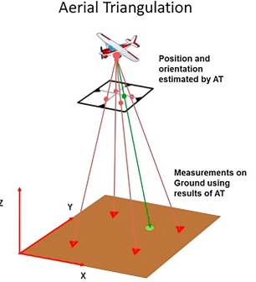
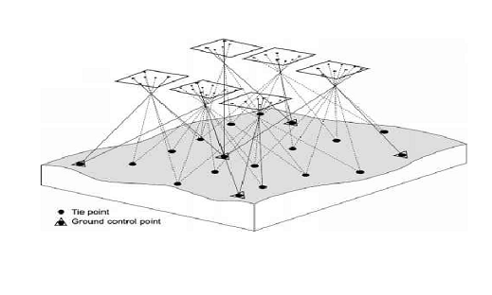
Mapping Tree and GPS
Aerial triangulation (AT) is a method for producing maps by overlapping aerial images.

Slide 5
Thank you
Questions?

